Slide 1
Team 5 : MID-WEST CAR RENTALS
Team Members:
Kedar Kaushikkar

Slide 2
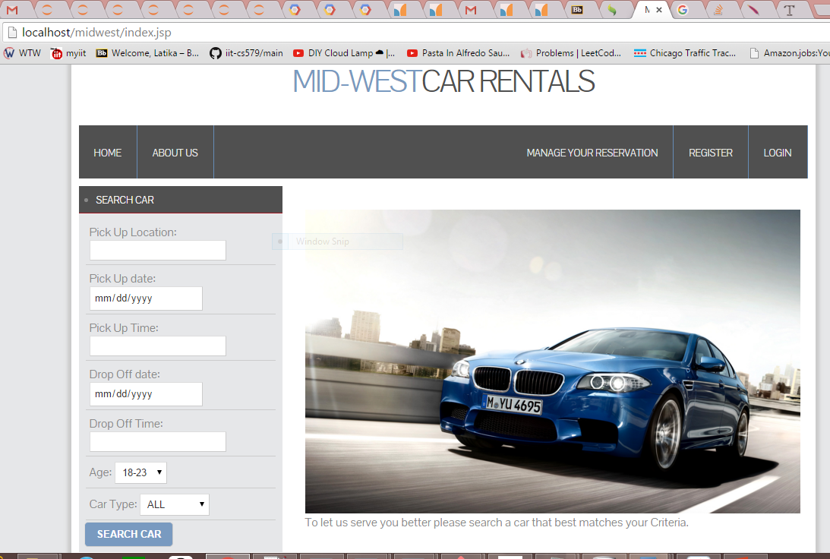
Index Page

Slide 3
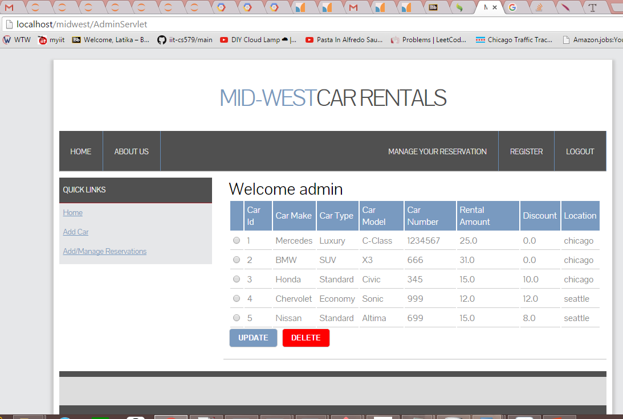
Admin Page

Slide 4
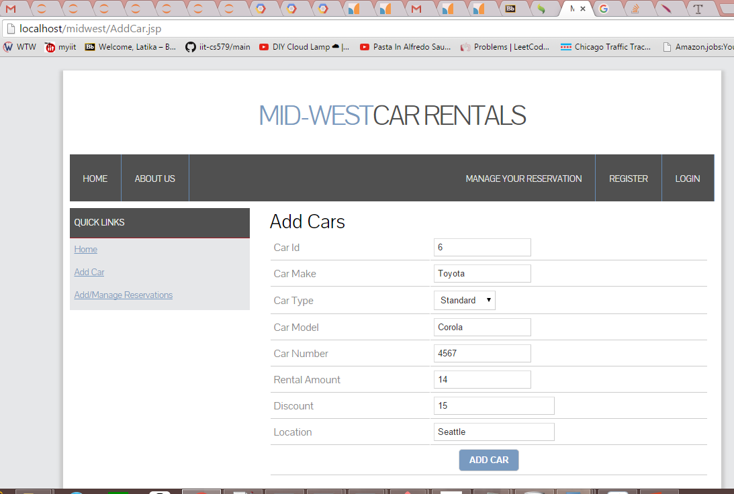
Add Car

Slide 5
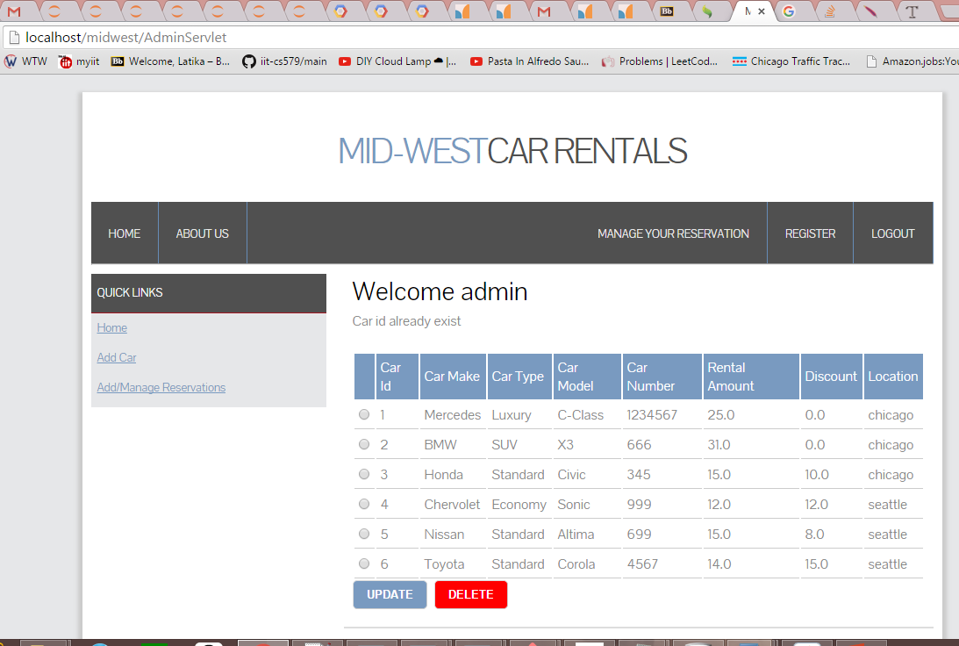
Car already exists

Slide 6
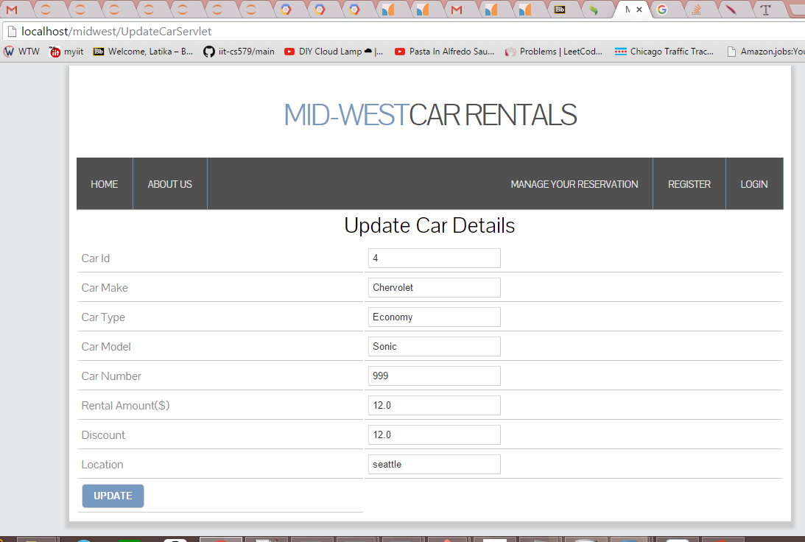
Update Car Details

Slide 7
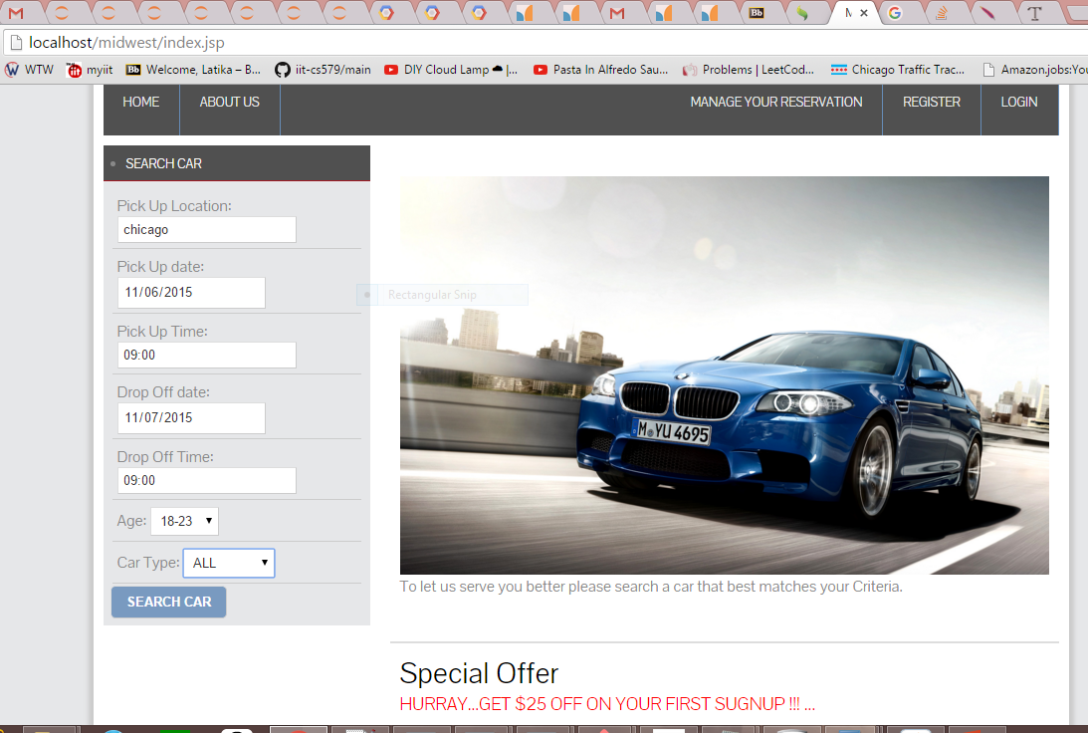
Search Car

Slide 8
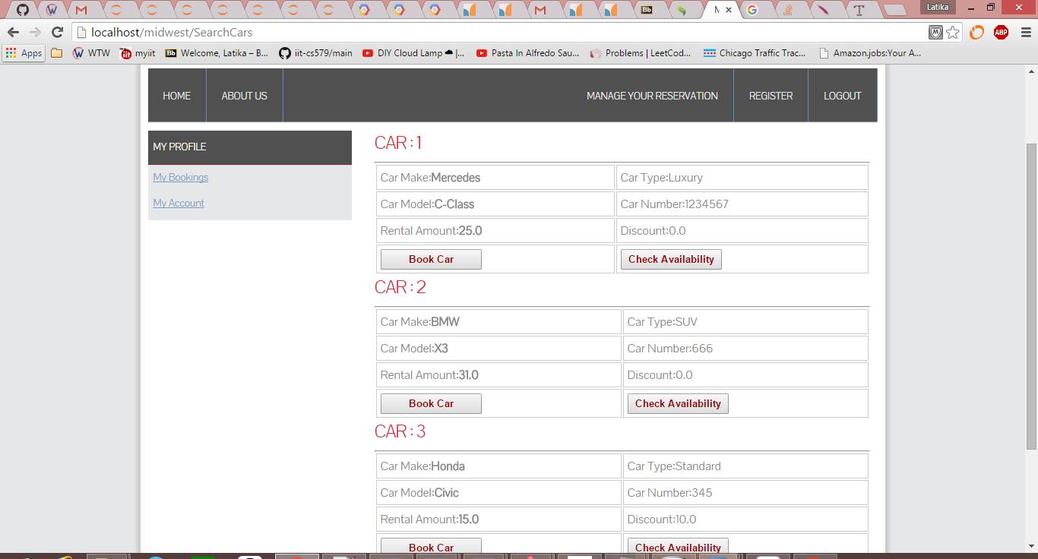
Book Car and Check Availability

